Slide 1

Plants VS Zombies
Notes:
https://scratch.mit.edu/projects/184131413/#editor

Slide 2
https://scratch.mit.edu/projects/126981912/editor

Slide 3


Scratch Scavenger Hunt
Sprite
Zombie
Cow
Peashooter
Backdrop
Save/Remix
Costumes
Sounds

Slide 4

BIG SECRET
Ask a mentor about using Alt-tab (or command-tab) to switch quickly between screens

Slide 5
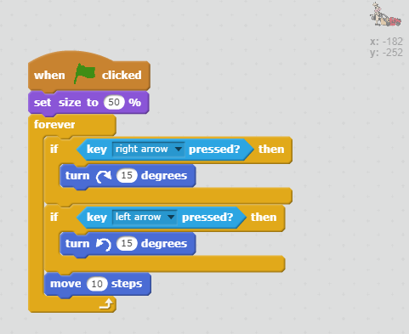
Cow Script

Slide 6
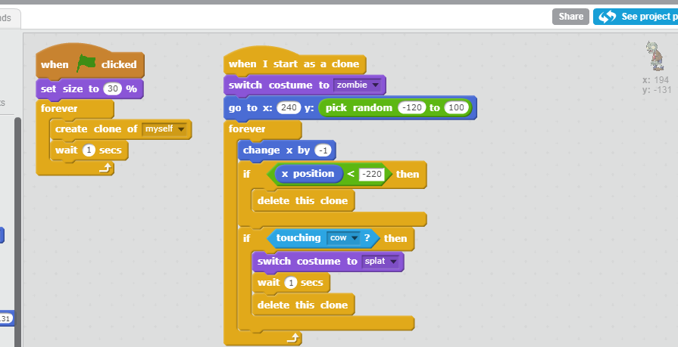
Zombie Script

Slide 7
Extensions
Use the Stage to make a cool background.
1
Try different cow speeds.
2
Try different zombie speeds and frequenies.
3
Make a different type of zombie that the cow has to avoid.
4

